Slide 1


Python Webapp Programming
Questionnaire app with Django
--use login/logout for question answering. Add signup

Slide 2
Utilize the new developed login for question answering
Make the view use Login Mixin thus must login then come to the views (start vote, voting, voted)
No need to record the user_name in session. User str(request.user) as user name (it is done by login to record user name)
Change to use template view instead of the function view.
Start_vote view inherited from View, Voting view inherited from FormView, Voted view inherited from TemplateView.

Slide 3
use git create branch and then later merge
PS> cd QuestionPrj
PS> git checkout –b add_class_view_signup_form

Slide 4
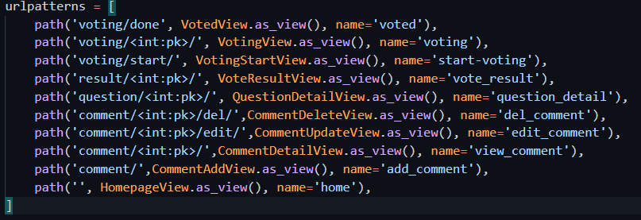
Changed urls.py
Import the new class view, and update the urlpatters to use new class view.

Slide 5
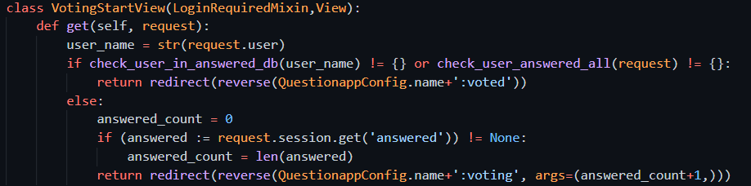
New start vote view
The view class definition:

Slide 6
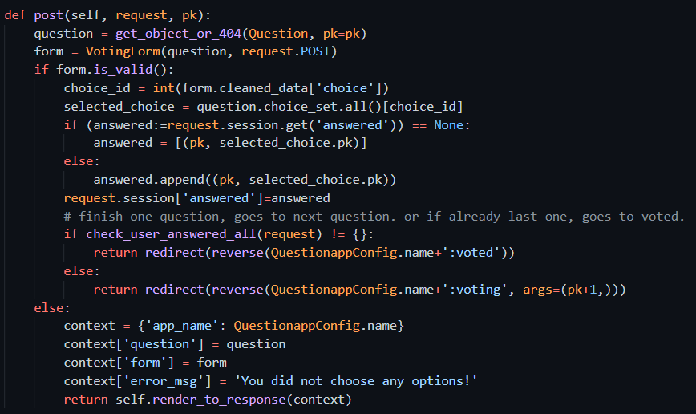
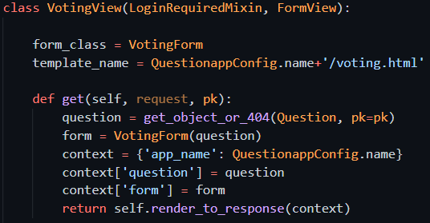
New voting view
View class definition:

Slide 7
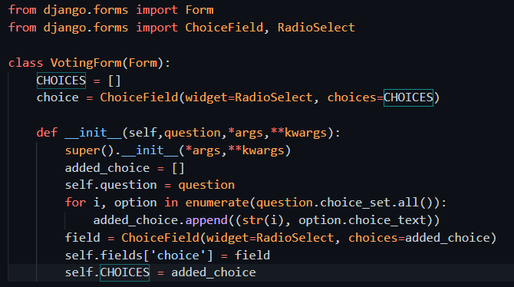
Add Questionapp/forms.py, dynamic form
Voting view need a form. Create a forms.py file
This is a dynamic form (fields cannot be decide fixed. It must be according to the content of question and choices)
This form when instantiated, the __init__ function will make it according to the question.

Slide 8
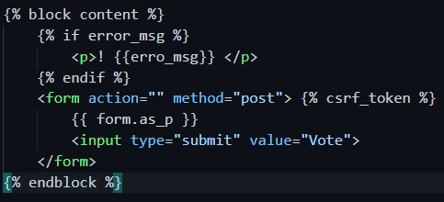
Chang the voting template to use the form defined

Slide 9
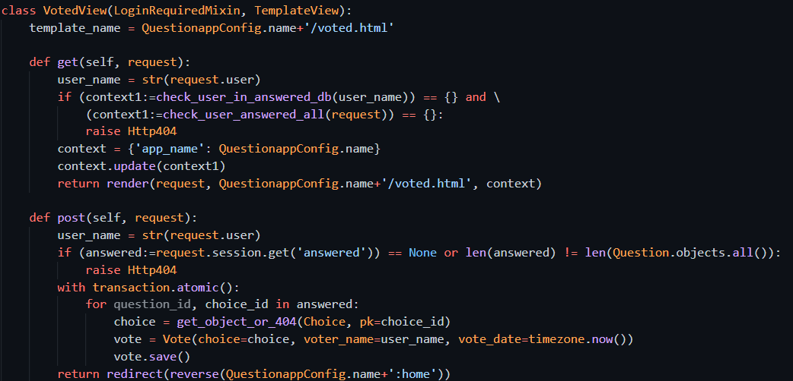
New voted view
View class definition.

Slide 10
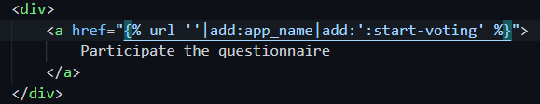
Changed home page link for start answering

Slide 11
Test it
Try test your new added code with the development server.
Or add test case and use Django test frame to test.

Slide 12
Add sign up for new user register
Django has a UserCreationForm. Also the user database using Django created default one.
We only need to add one signup url conf, add view, add template, then put the sign up link in proper place in your site.

Slide 13
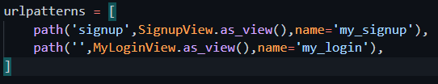
Add url conf
New app user
Add urls.py for the new app
In site urls include this app urls
PS> py manage.py createapp user
PS> cd user
PS> ni urls.py

Slide 14
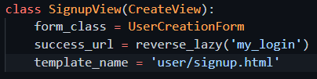
Add a view for the new signup
New signup view class

Slide 15
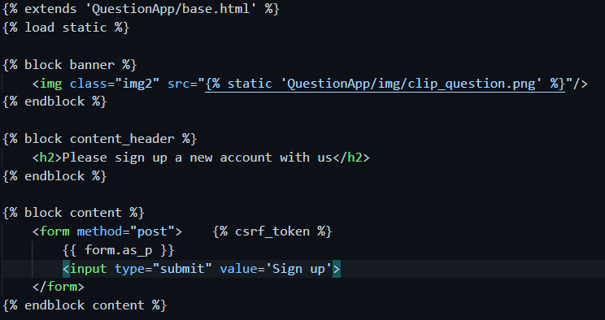
Create template for signup
User/templates/user/signup.html

Slide 16
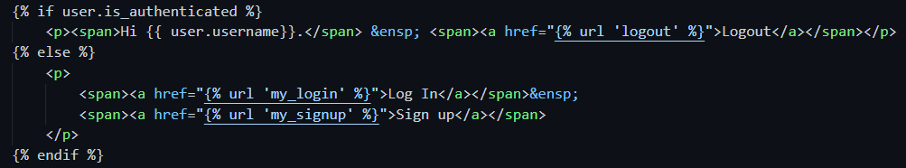
Add signup link at homepage

Slide 17
Test it. And further thinking
The frequently needed function we still missing is password change. This Django already has a default one which we can use.
To see the default password change: http://localhost:8000/accounts/password_change/
And still another function: password reset, allow the user recover password/reset password if he/she forget it. This at real production environment will normally need email service to accomplish, or many web sites uses message to cellphone to verify. Only successfully verified user can reset password.

Slide 18
Email backend to console
Add this in the site settings.py

Slide 19
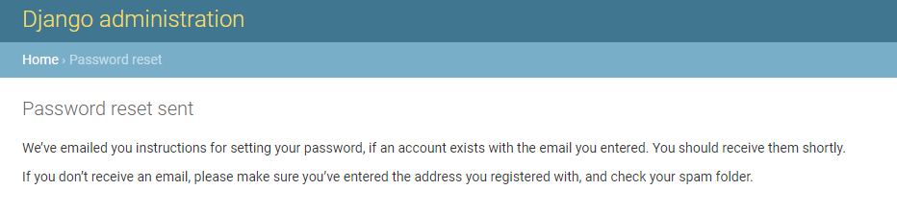
Provide email for password reset
http://localhost:8000/accounts/password_reset/

Slide 20
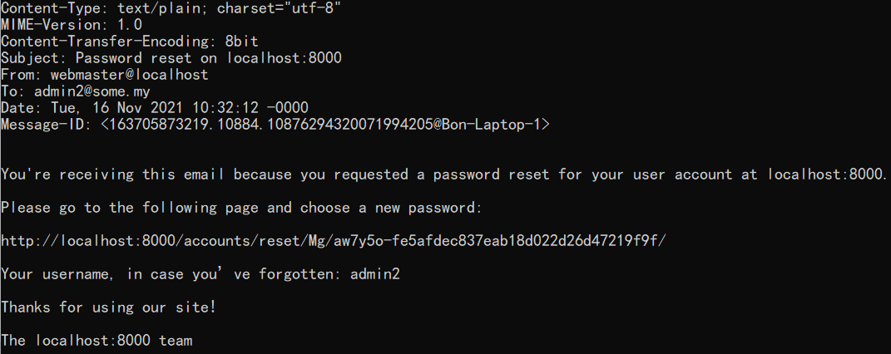
Email was in console where we started server

Slide 21
And again some further thinking
You can create a user profile page, which allow the user to modify his information, including change password.
When login, allow a ‘forget password’ button to offer password reset to user.

Slide 22
Commit branch change, merge to main, Push to remote, deploy to Heroku
PS> cd %Project_Root_folder%
PS> git status
PS> git add –A
PS> git commit –m “add signup, add class view”
PS> git checkout main
PS> git merge add_class_view_signup_form
PS> git tag V1.0 –m “release v1.0”
PS> git push origin main
PS> git push heroku main
PS> heroku ps:scale web=1

